Slide 1
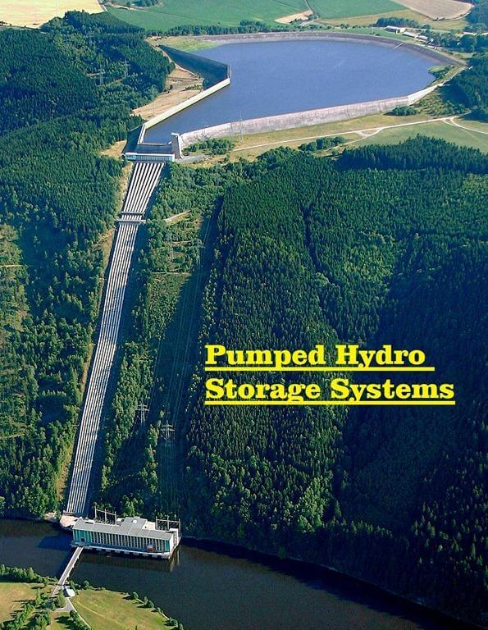





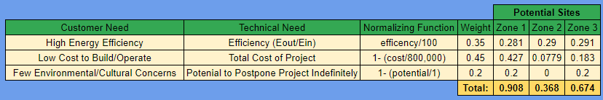

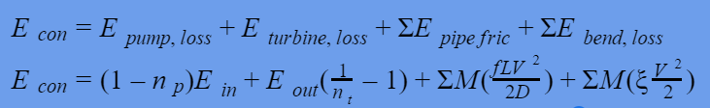
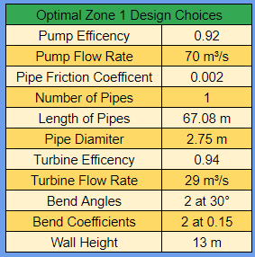
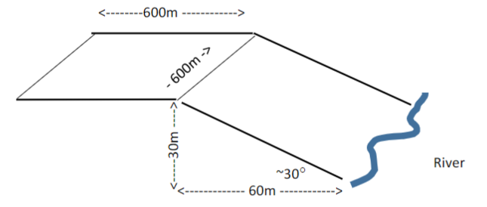
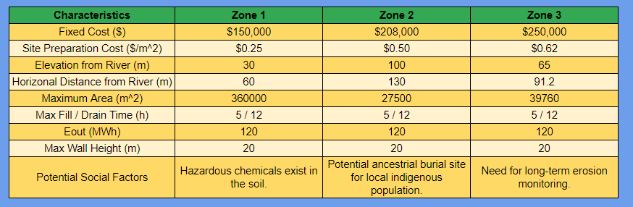
Modeling a Solar-Hydro Storage System
Team 30 - Alyssa Devincenzi, Natalie Harvey, Matthew Stuber, & Agathiya Tharun
Introduction
Problem Description:
Design a hydro storage system to store energy from a solar field
Goals for the system:
High Efficiency
Low Cost
Few Environmental and Cultural Concerns
Energy Loss Factors
Pipe Friction
Energy in the water is lost to the pipe
Bends
Creates turbulence which dissipates energy
Turbine and Pump Efficiency
Balance between efficiency and cost
Factors Considered Negligible
Evaporation - 0.26% mass loss per day
Temperature affecting pipe length - 0.0006% efficiency loss⁴
Leaks in pipes - 0.34% mass loss per day²
Animals/People falling into reservoir - 0.007% mass loss per incident
Physics Model
Downhill
Mass - derived from downhill UAE
Mass is calculated first - used for final equation
Energy consumption - does not include pump
Uphill
Input Energy - derived from uphill UAE
Use the result from mass calculations
Energy consumption - does not include turbine
Site Specifications
Program Development
Features of the Program
User Friendly
Performs efficiency analysis AND cost analysis
Outputs both inputs and results to a text file for future review
If desired, contains a module that will take a range of parameters and output ALL potential designs to a CSV file.
Conclusions
Optimal Results for Each Potential Site
Choosing The Overall Optimal Design
Proposed Site and Design Choices
Fg. 3: Universal Accounting Equation (UAE)
Fg. 1: Wendefurth Pumped Storage Power Plant¹
Fg. 4: Mass Equation
Fg. 7: Optimized Results by Zone
Fg. 5: Energy Input Equation
Fg. 8: Decision Matrix
Fg. 2: Energy Consumption Equation
Fg. 10: Zone 1 Layout
Fg. 6: Specifications by Zone³
Citations
https://www.windpowerengineering.com/pumped-hydro-storage-market-to-surpass-350-billion-by-2024/ - 1
https://www.lmnoeng.com/Flow/LeakRate.php - 2
https://doi.org/10.1016/j.rser.2018.03.003 - 3
https://www.engineeringtoolbox.com/thermal-expansion-pipes-d_283.html - 4
https://www.medicinenet.com/body_surface_area/definition.htm - 5
Fg. 9: Proposed Design Choices
Notes:
Video Presentation: https://www.youtube.com/watch?v=QWtYACdzOog

